Slide 1
Analysis of Grain Demand and Production
Understanding Food Security Challenges and Solutions

Slide 2
Project Overview
Objective: To analyze grain demand and production data to inform food security strategies.
SDG alignment: Zero Hunger(goal 2)- ensuring access to safe, nutritious food for all.
Achieving Zero Hunger is not just a global challenge but a personal mission. I believe everyone deserves access to safe and nutritious food. By analyzing grain demand and production, I aim to contribute to strategies that alleviate hunger and enhance food security for future generations.

Slide 3
Problem Definition
Increasing Demand for Grains:
Population Growth: The rising global population will significantly increase grain demand by 2032, straining agricultural systems.
Climate Change: Extreme weather events disrupt farming cycles, lowering grain yields and threatening food security.
Significance of the Problem:
Food Insecurity: High demand and production challenges can lead to shortages, impacting vulnerable populations.
Sustainable Development: Addressing grain demand is essential for achieving Goal 2 (Zero Hunger) and ensuring access to nutritious food for all.

Slide 4
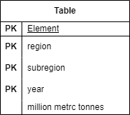
Database Design
CREATE TABLE GrainData (
element VARCHAR(50) NOT NULL,
region VARCHAR(50) NOT NULL,
subregion VARCHAR(50) NOT NULL,
year INT NOT NULL,
millions_metric_tonnes DECIMAL(10, 2),
PRIMARY KEY (element, region, subregion, year));

Slide 5
Database Schema
The GrainData table is designed to store information related to grain demand and production across various regions and subregions for different years. The key attributes in the table include:
Element: Represents the type of data being captured, such as food grain demand, total grain demand, grain production, or implied additional supply required.
Region: Indicates the broader geographic area (e.g., Asia, Sub-Saharan Africa) where the data is collected.
Subregion: Refines the location within the region (e.g., Southeast Asia, West Africa), allowing for more detailed analysis.
Year: The year of the data, currently focusing on 2022 and 2032 to provide insight into present and future projections.
Millions_Metric_Tonnes: Represents the quantity of grains, measured in millions of metric tonnes. This numeric field provides the actual value of demand, production, or supply required.
Primary Key (Composite): The combination of element, region, subregion, and year ensures that each record is unique, allowing for analysis at multiple levels of granularity (both geographical and temporal).

Slide 6
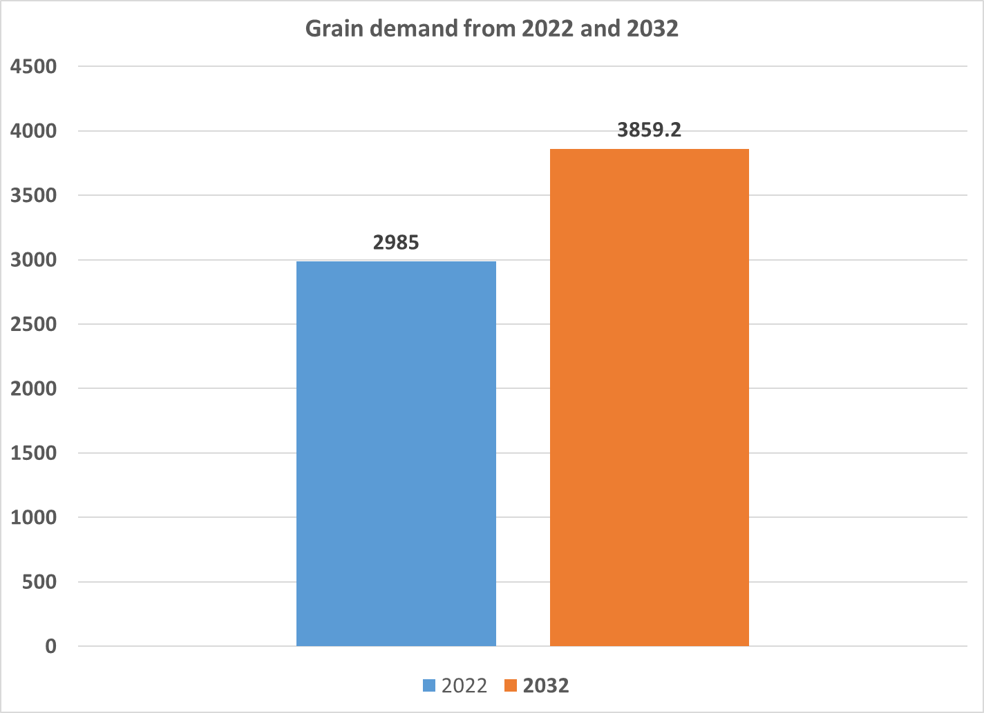
Data Analysis Insights - 1
Between 2022 and 2032, there is a significant rise in total grain demand, increasing from 2,985 million metric tonnes to 3,859.2 million metric tonnes. This represents a 29.3% increase over the decade.
This steep increase highlights the need for sustainable agricultural practices, improved production technologies, and international cooperation to ensure food security, especially in vulnerable regions

Slide 7
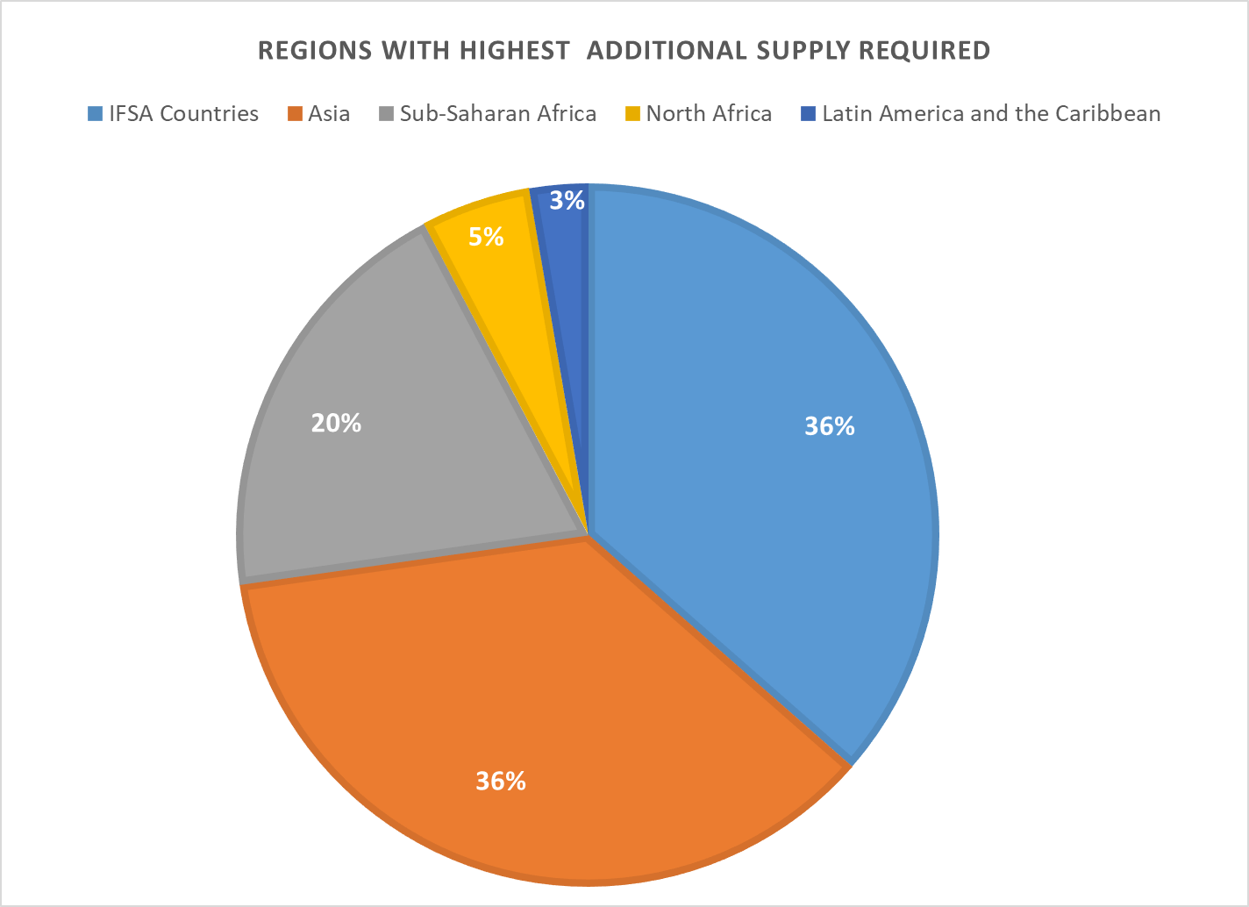
Data Analysis Insights - 2
IFSA Countries: Require 912.7 million metric tonnes of additional grain supply, indicating widespread demand across food-insecure regions.
Asia: Needs 908.5 million metric tonnes, reflecting the growing population and dietary changes across countries like India and China.
Sub-Saharan Africa: Requires 488.9 million metric tonnes due to low domestic production capacity and high population growth.
These regions highlight where targeted interventions such as boosting domestic production are urgently needed to meet future grain demand.

Slide 8
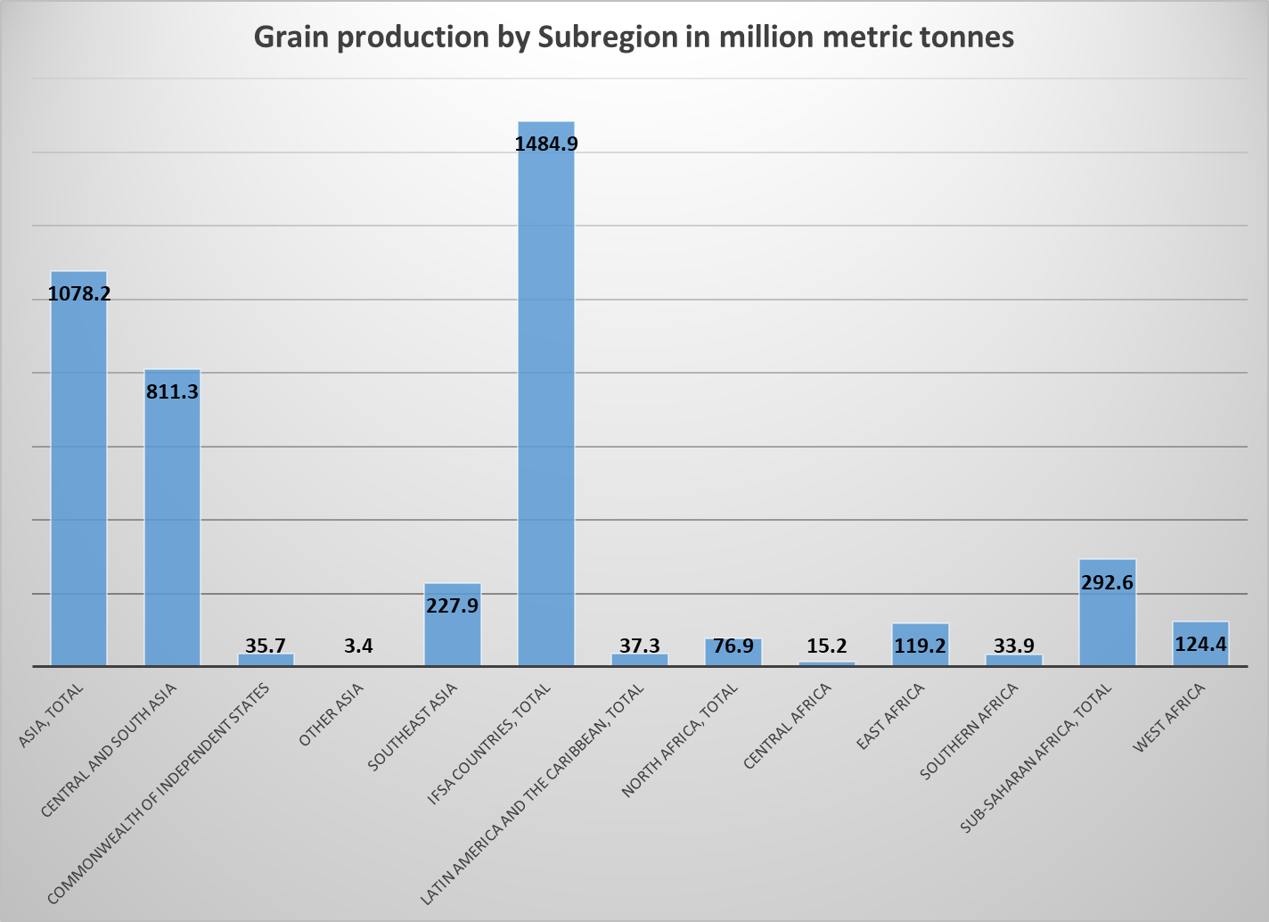
Data Analysis Insights - 3
Asia (24.8% of total production): Asia is the largest contributor to global grain production, followed by IFSA, Sub-Saharan Africa (SSA), and North Africa (NA). These top contributors are essential in shaping the future of global food security. Ensuring the sustainability of their production, while supporting regions with deficits, will be key to achieving the UN’s Zero Hunger goal

Slide 9
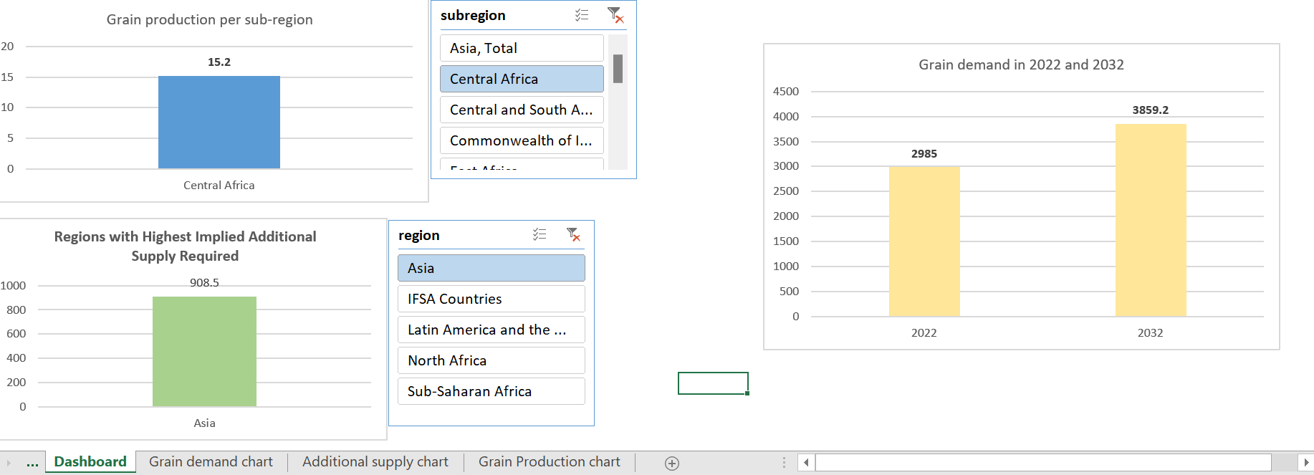
Dashboard

Slide 10
THANK YOU!

